Slide 1

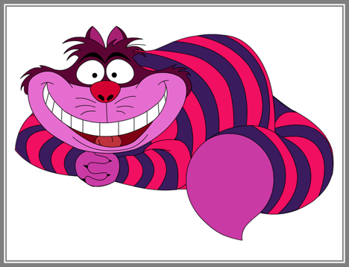


Everyone is important!

Slide 2


Wonderland Community Services has 2 sites…
One in Tasmania called Wonderland Retreat AND
One in Queensland called Pirates Rest
WHERE DO YOU LIVE in TASMANIA OR QUEENSLAND?

Slide 3

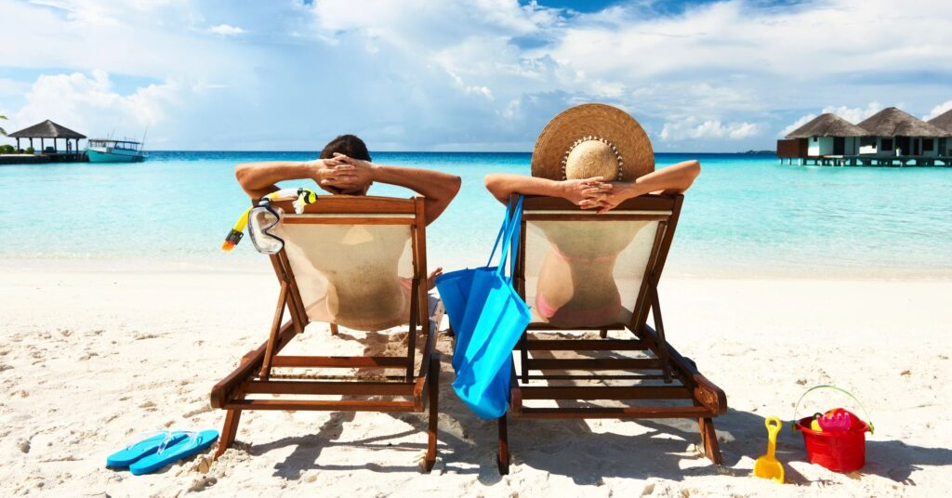

What do we do here?
We have fun, visit new places, learn new things, meet new people and have a break.

Slide 4
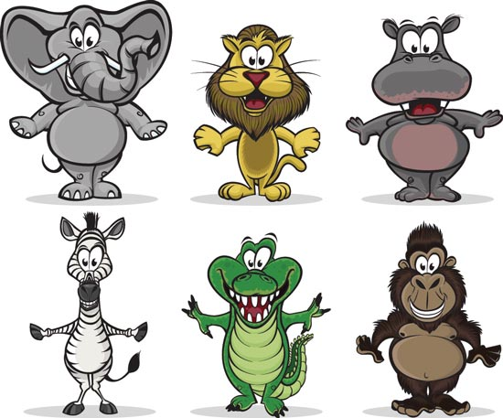
We all know that every person is different.
Some of us are little, some of us are big, some of us are wide and some of us are thin, some of us are white and some of us are black and different colours in between and we all have very different things we can DO!!!
Not one of us are the same!

Slide 5
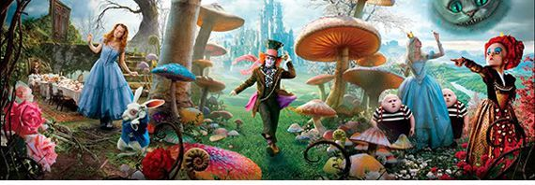
At Wonderland & Pirates….we want everyone to feel happy because everyone is important!

Slide 6
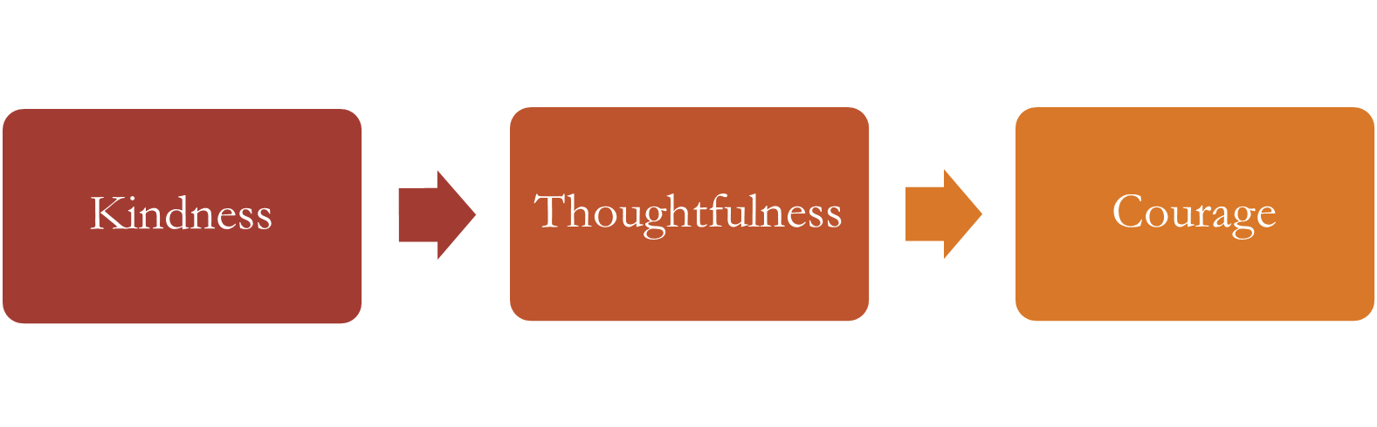
Wonderland Values

Slide 7
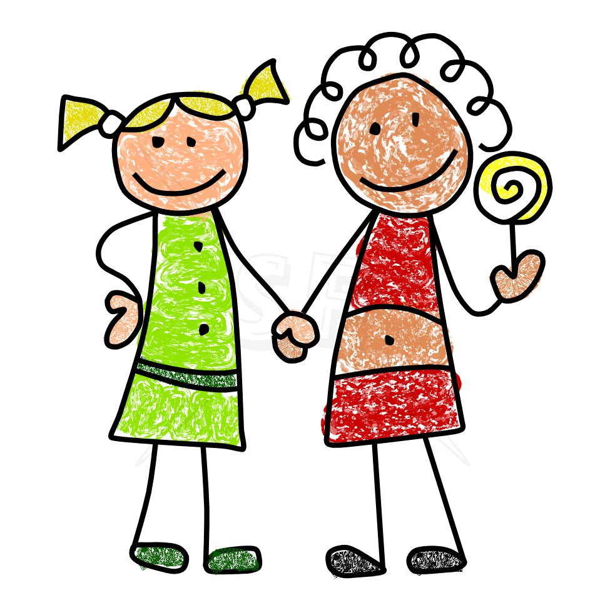
Kindness
Means including everyone so that they don’t feel left out.

Slide 8
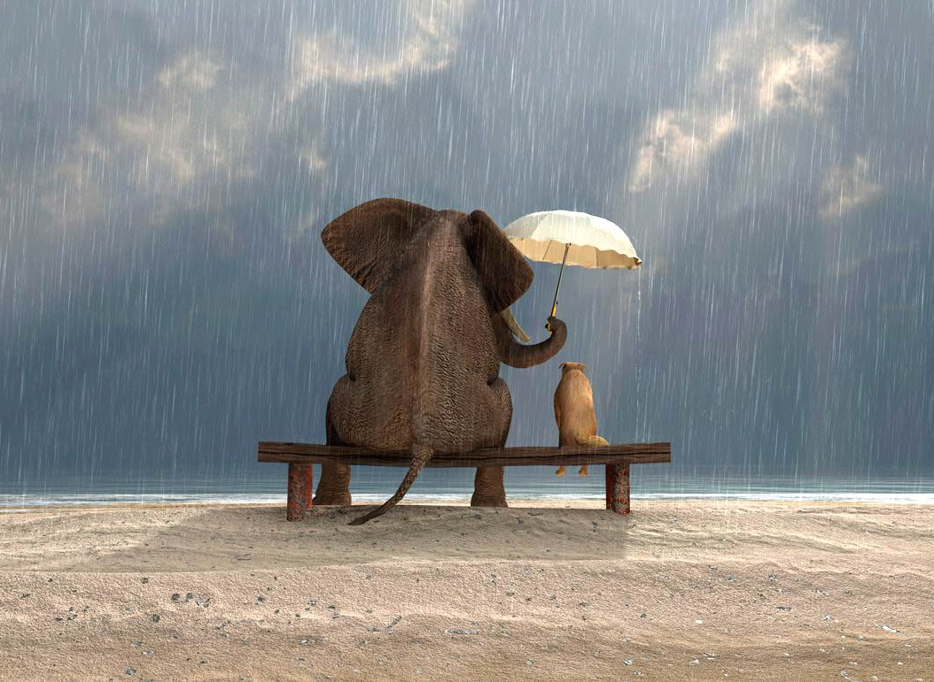
Thoughtful
Means thinking about what someone might need and offering help.

Slide 9
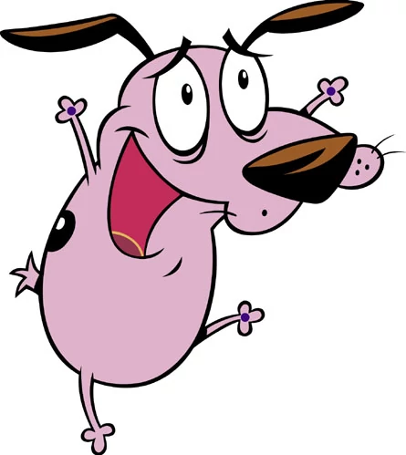
Courage
Means – being brave and trying new things and meeting new people.

Slide 10
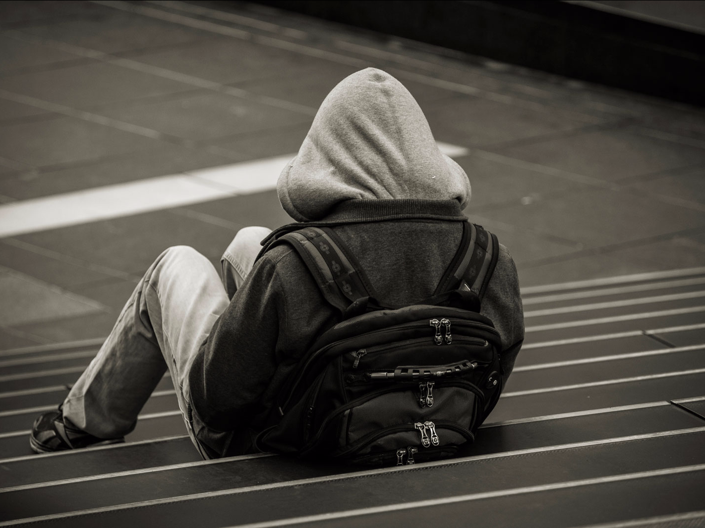
If someone is unhappy…..
Be friendly to them
Ask if they need help
Talk to your carer

Slide 11


If you are unhappy….feeling sad, mad or bad…we’d like to help you feel glad!
We want to see how we can put a smile on your dial again! So, tell us kindly….how you are feeling.

Slide 12
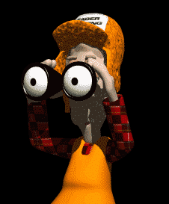
Your rights
You are welcome at Wonderland & Pirates.
You are free to come and have a look around and talk to us.
You can decide if you would like to come to a retreat or live in one of our houses or like us to help you at home.
You can decide to leave us as well!
On our Websites, under ‘About’, you will find a tab labelled ‘Policies’. Please feel free to visit these pages
Access to and exit from the service.

Slide 13
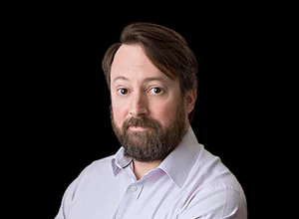
Your rights
You can tell us about your needs, what you would like and your hopes and goals.
Input into individual needs, goals and aspirations.

Slide 14
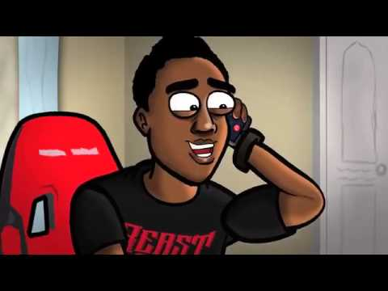
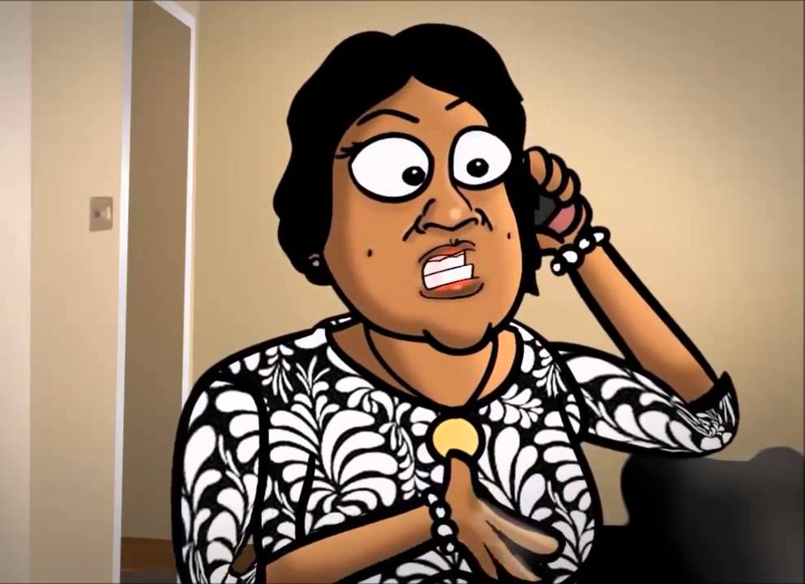
Your Rights
You have the right to call your family, friends or carer.
If it is urgent you can ask to contact them immediately and your carer will help you do this.
Connectedness or involvement with family, friends and community.

Slide 15

Your Rights
As each person is different and comes from a different culture, has different beliefs and values, different racial heritage, is a different age, sex and has different abilities
We want you to feel free to tell us all about yourself. You will be respected.
Acknowledgement of cultural background, beliefs, values, ethnicity, age, gender and abilities.

Slide 16

Your rights
Your private information will be kept private. We keep this safe and our staff sign a form to say they will keep your information private.
Confidentiality of their private information and how information collected will be stored and used.

Slide 17
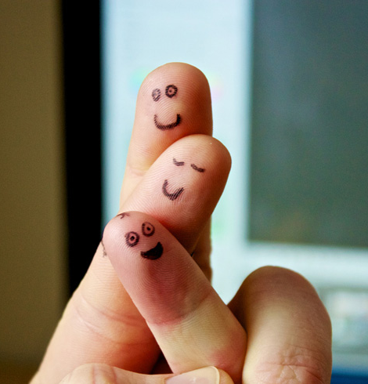
Your rights
You have the right to be safe when you are here with us and when you are out in the community.
This means safety for your body and safety for your feelings.
Please let us know if you don’t feel safe at any time. Your carer will help you.
Safety while using a service and any specific policy, training and accreditation systems to address this.

Slide 18

Your rights
You have a right to make a complaint – complaint forms are on our websites.
Your feedback is important – after each stay you will be asked to provide your feedback on a little feedback form. After 6 months we will ask you to provide a lot of feedback! We will use this to improve our services.
For any incidents we will fill out a form to make sure we have helped the best way we can including by making contact with our Managers. Incident Reports will be saved for future reference. You can request a copy.
We have emergency planning in place for you- its always best to be prepared for an emergency.

Slide 19

Our staff
We love our staff too…they deserve kindness, respect and safety as well.
Make sure that you look out for them treat them well…and tell them when they are doing a great job!

Slide 20
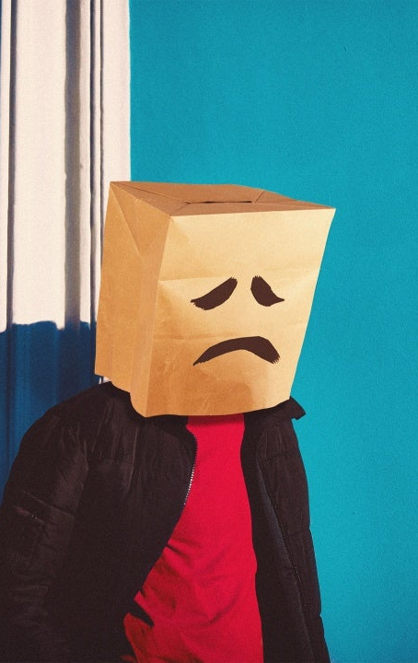
Our golden rules…..
No nasty swearing at people.
No damaging property, breaking things or throwing stuff.
No hitting, pushing, kicking or spitting.
No picking on people, hurting their feelings deliberately.
No hurting animals.

Slide 21

Our golden rules…..
No stealing (includes food from the fridge or cupboard without asking).
No going into other people’s rooms without their permission.
No wearing shoes in the house.
No touching people’s bodies if they don’t want you to.
No ignoring or disobeying carers (they are trying to help everyone have a good time and be safe).

Slide 22
What happens if I break the rules?
Walk the plank?
Leave the rabbit hole?

Slide 23

Yes – We have to have some rules
Rules keep everyone safe and happy – and we want everyone to be happy because EVERYONE IS IMPORTANT.
If you do break the rules – say sorry quickly.
If you break the rules badly – then we might have to say – its time to leave…

Slide 24

At Wonderland…and Pirates…. I am Important
Everyone at Wonderland is important…all our participants, guests, our staff, our families…we all matter. We want to be a big happy family.

